Slide 1
CLASSIFICATION OF GENETIC MUTATIONS
Atul Rana 15-1-5-073
Abhigyan Kashyap 15-1-5-042
Sumit Kumar 15-1-5-014
Purushottam Gaudel 15-1-5-055
UNDER THE SUPERVISION OF:
DR. BADAL SONI and DR. ANISH KUMAR SAHA
Computer Science And Engineering Department,
National Institute of Technology, Silchar
CLASSIFICATION OF GENETIC MUTATIONS
Notes:
<number>

Slide 2
Table of Contents
Genetic Mutation
Workflow
Literature Survey
Motivation
Problem Statement
Objective
Supervised Learning
Proposed Work
Dataset
Encoding Techniques
Experimental Results
Performance Matrix
Critical Conclusion
Future Work
Reference
Notes:
INTRODUCTION
Nucleotides form the basic structural unit of nucleic acids such as DNA.
Adenine, thymine, cytosine and guanine are the four nucleotides found in DNA.
One of the most exciting frontiers for machine learning is the field of medical diagnosis, where background information and nuanced decision-making are considered essential.
When Memorial Sloan Kettering (MSK) released a Kaggle competition entitled “Personalized Medicine: Redefining Cancer Treatment,” we took on the controversial challenge of creating models that could perform the same tasks as experienced genomic researchers.
1- 9 classification. Some classes are cancer-causing and some aren’t. So, we classified the mutations into these classes.
Lets move to the goal of our model.
Machine Learning methods are still far from perfectly replicating the work of skilled oncologists, we put together a number of tools that cancer researchers can use in conjunction with the classification model. To speed up this time-consuming process, we made our model interpretable by showing the distribution of probability of a particular mutation belonging to each class.
Genes included in the training and test datasets were almost entirely different, and since the gene/mutation datasets contained limited information, we turned most of our attention to the text data.
<number>

Slide 3
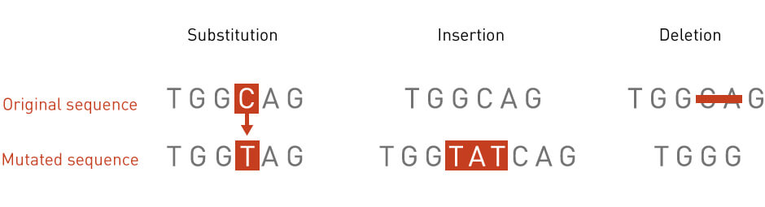
.
Genetic Mutation
Any type of change in DNA structure
Genetic disorders like color blindness, cancer
CLASSIFICATION OF GENETIC MUTATIONS
<number>
Notes:
INTRODUCTION
Nucleotides form the basic structural unit of nucleic acids such as DNA.
Adenine, thymine, cytosine and guanine are the four nucleotides found in DNA.
One of the most exciting frontiers for machine learning is the field of medical diagnosis, where background information and nuanced decision-making are considered essential.
When Memorial Sloan Kettering (MSK) released a Kaggle competition entitled “Personalized Medicine: Redefining Cancer Treatment,” we took on the controversial challenge of creating models that could perform the same tasks as experienced genomic researchers.
1- 9 classification. Some classes are cancer-causing and some aren’t. So, we classified the mutations into these classes.
Lets move to the goal of our model.
Machine Learning methods are still far from perfectly replicating the work of skilled oncologists, we put together a number of tools that cancer researchers can use in conjunction with the classification model. To speed up this time-consuming process, we made our model interpretable by showing the distribution of probability of a particular mutation belonging to each class.
Genes included in the training and test datasets were almost entirely different, and since the gene/mutation datasets contained limited information, we turned most of our attention to the text data.
<number>

Slide 4
Workflow
PATIENTS
DOCTORS EXAMINE
OBSERVE DNA SEQUENCE
FIND EVIDENCE
DECISION
CLASSIFY
ANALYSE
COMPARE WITH CLINICAL LITERATURE
GOAL:
Speed up time-consuming process for cancer researchers.
CLASSIFICATION OF GENETIC MUTATIONS
<number>
Notes:
INTRODUCTION
Nucleotides form the basic structural unit of nucleic acids such as DNA.
Adenine, thymine, cytosine and guanine are the four nucleotides found in DNA.
One of the most exciting frontiers for machine learning is the field of medical diagnosis, where background information and nuanced decision-making are considered essential.
When Memorial Sloan Kettering (MSK) released a Kaggle competition entitled “Personalized Medicine: Redefining Cancer Treatment,” we took on the controversial challenge of creating models that could perform the same tasks as experienced genomic researchers.
1- 9 classification. Some classes are cancer-causing and some aren’t. So, we classified the mutations into these classes.
Lets move to the goal of our model.
Machine Learning methods are still far from perfectly replicating the work of skilled oncologists, we put together a number of tools that cancer researchers can use in conjunction with the classification model. To speed up this time-consuming process, we made our model interpretable by showing the distribution of probability of a particular mutation belonging to each class.
Genes included in the training and test datasets were almost entirely different, and since the gene/mutation datasets contained limited information, we turned most of our attention to the text data.
<number>

Slide 5
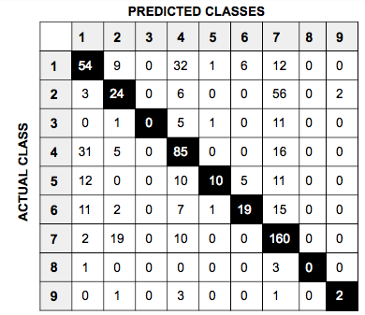
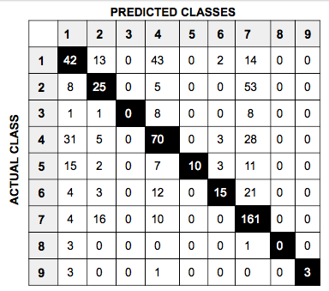
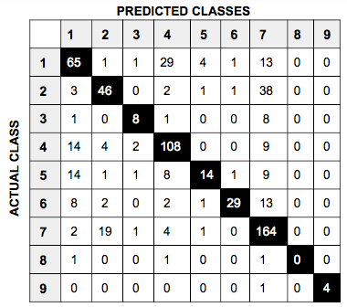
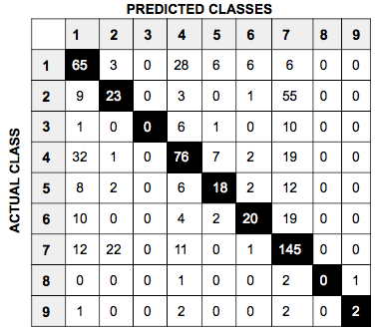
Word 2 Vec
NV
LR
RF
SVM

Slide 6
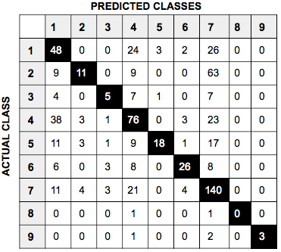
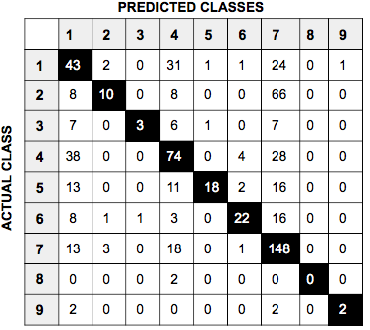
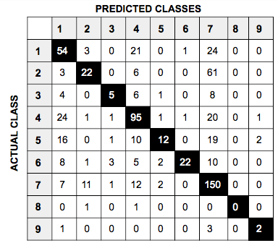
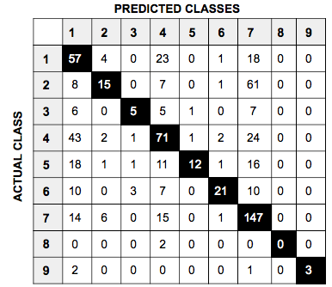
Doc 2 vec
LR
NB
SVM
RF

Slide 7
Literature Survey
PAPER NAME | AUTHOR | YEAR | METHODOLOGIES | MERITS | DEMERITS
KNN with TF-IDF Based Framework for Text Categorization | Bruno Trstenjak, Sasa Mikac, Dzenana Donko/ Procedia Engineering | 2014 | KNN + Tfidf | Supervised Model, Online updatating | Sensitive to irrelevant feature, need high feature preprocessing.
Distributed Representations of Words and Phrases and their Compositionality | Tomas, Ilya Sutskever, Kai Chen, Jeffrey, Greg/ Cornell University library | 2015 | Vector representations to capture precise syntactic and semantic word relationships | Accuray + Speed Up | Very Memory intensive process
Document Clustering | Prafulla Bafna, Dhanya Pramod, Anagha Vaidya | 2016 | Apply TF-IDF followed by hierarchical agglomerative clustering(HAC) and fuzzy K-means algorithm with iteration. | Unsupervised + stacking two Algo can obtain tighter clustering | Hard to define K, long computational time, sensitive to initial guess
CLASSIFICATION OF GENETIC MUTATIONS
<number>
Notes:
INTRODUCTION
Nucleotides form the basic structural unit of nucleic acids such as DNA.
Adenine, thymine, cytosine and guanine are the four nucleotides found in DNA.
One of the most exciting frontiers for machine learning is the field of medical diagnosis, where background information and nuanced decision-making are considered essential.
When Memorial Sloan Kettering (MSK) released a Kaggle competition entitled “Personalized Medicine: Redefining Cancer Treatment,” we took on the controversial challenge of creating models that could perform the same tasks as experienced genomic researchers.
1- 9 classification. Some classes are cancer-causing and some aren’t. So, we classified the mutations into these classes.
Lets move to the goal of our model.
Machine Learning methods are still far from perfectly replicating the work of skilled oncologists, we put together a number of tools that cancer researchers can use in conjunction with the classification model. To speed up this time-consuming process, we made our model interpretable by showing the distribution of probability of a particular mutation belonging to each class.
Genes included in the training and test datasets were almost entirely different, and since the gene/mutation datasets contained limited information, we turned most of our attention to the text data.
<number>

Slide 8
Literature Survey
PAPER NAME | AUTHOR | YEAR | METHODOLOGIES | MERITS | DEMERITS
Text Mining for Precision Medicine Biomedical literature to understand genes and health | Michael,Ayush,Zhiyong /National Center for Biotechnology Information/ | 2017 | Database curation, information Extraction and Hypothesis Generation | Health treatment decision. Risk Prediction | Hard to reach real life usable accuracy.
Machine learning applications in cancer prognosis and prediction | K. Kourou et al. / Computational and Structural Biotechnology | 2015 | ANN,DT,NB,KNN | Use of ML tools in Cancer Diagnosis | Very hard to implement and use in real.
An improved K-nearest-neighbor algorithm for text categorization | Jiang et al./Expert Systems with Applications | 2015 | KNN | Improved KNN, outperform general, LR,NB, SVM | Sensitive to irrelevant feature
CLASSIFICATION OF GENETIC MUTATIONS
<number>
Notes:
INTRODUCTION
Nucleotides form the basic structural unit of nucleic acids such as DNA.
Adenine, thymine, cytosine and guanine are the four nucleotides found in DNA.
One of the most exciting frontiers for machine learning is the field of medical diagnosis, where background information and nuanced decision-making are considered essential.
When Memorial Sloan Kettering (MSK) released a Kaggle competition entitled “Personalized Medicine: Redefining Cancer Treatment,” we took on the controversial challenge of creating models that could perform the same tasks as experienced genomic researchers.
1- 9 classification. Some classes are cancer-causing and some aren’t. So, we classified the mutations into these classes.
Lets move to the goal of our model.
Machine Learning methods are still far from perfectly replicating the work of skilled oncologists, we put together a number of tools that cancer researchers can use in conjunction with the classification model. To speed up this time-consuming process, we made our model interpretable by showing the distribution of probability of a particular mutation belonging to each class.
Genes included in the training and test datasets were almost entirely different, and since the gene/mutation datasets contained limited information, we turned most of our attention to the text data.
<number>

Slide 9
Motivation
Analysing clinical literature is labour intensive
Takes huge amount of time
Possibility of human error
Life risk at wrong analysis
Is it possible to automate the analysis, with less error, in less time, cutting off life risks?
CLASSIFICATION OF GENETIC MUTATIONS
<number>
Notes:
INTRODUCTION
Nucleotides form the basic structural unit of nucleic acids such as DNA.
Adenine, thymine, cytosine and guanine are the four nucleotides found in DNA.
One of the most exciting frontiers for machine learning is the field of medical diagnosis, where background information and nuanced decision-making are considered essential.
When Memorial Sloan Kettering (MSK) released a Kaggle competition entitled “Personalized Medicine: Redefining Cancer Treatment,” we took on the controversial challenge of creating models that could perform the same tasks as experienced genomic researchers.
1- 9 classification. Some classes are cancer-causing and some aren’t. So, we classified the mutations into these classes.
Lets move to the goal of our model.
Machine Learning methods are still far from perfectly replicating the work of skilled oncologists, we put together a number of tools that cancer researchers can use in conjunction with the classification model. To speed up this time-consuming process, we made our model interpretable by showing the distribution of probability of a particular mutation belonging to each class.
Genes included in the training and test datasets were almost entirely different, and since the gene/mutation datasets contained limited information, we turned most of our attention to the text data.
<number>

Slide 10
Problem Statement
Classify the given genetic variations on evidence
from text-based clinical literature.
Proposed solution:
Developing interpretable machine learning model which analyze the clinical literature and save time by automatically classifying genetic variations
CLASSIFICATION OF GENETIC MUTATIONS
<number>
Notes:
INTRODUCTION
Nucleotides form the basic structural unit of nucleic acids such as DNA.
Adenine, thymine, cytosine and guanine are the four nucleotides found in DNA.
One of the most exciting frontiers for machine learning is the field of medical diagnosis, where background information and nuanced decision-making are considered essential.
When Memorial Sloan Kettering (MSK) released a Kaggle competition entitled “Personalized Medicine: Redefining Cancer Treatment,” we took on the controversial challenge of creating models that could perform the same tasks as experienced genomic researchers.
1- 9 classification. Some classes are cancer-causing and some aren’t. So, we classified the mutations into these classes.
Lets move to the goal of our model.
Machine Learning methods are still far from perfectly replicating the work of skilled oncologists, we put together a number of tools that cancer researchers can use in conjunction with the classification model. To speed up this time-consuming process, we made our model interpretable by showing the distribution of probability of a particular mutation belonging to each class.
Genes included in the training and test datasets were almost entirely different, and since the gene/mutation datasets contained limited information, we turned most of our attention to the text data.
<number>

Slide 11
Objective
Increase efficiency and accuracy of genomic researchers
Automate the task of distinction between driver and passenger mutations
Train the model iteratively for better results
To further improve the model for real time use
CLASSIFICATION OF GENETIC MUTATIONS
<number>
Notes:
INTRODUCTION
Nucleotides form the basic structural unit of nucleic acids such as DNA.
Adenine, thymine, cytosine and guanine are the four nucleotides found in DNA.
One of the most exciting frontiers for machine learning is the field of medical diagnosis, where background information and nuanced decision-making are considered essential.
When Memorial Sloan Kettering (MSK) released a Kaggle competition entitled “Personalized Medicine: Redefining Cancer Treatment,” we took on the controversial challenge of creating models that could perform the same tasks as experienced genomic researchers.
1- 9 classification. Some classes are cancer-causing and some aren’t. So, we classified the mutations into these classes.
Lets move to the goal of our model.
Machine Learning methods are still far from perfectly replicating the work of skilled oncologists, we put together a number of tools that cancer researchers can use in conjunction with the classification model. To speed up this time-consuming process, we made our model interpretable by showing the distribution of probability of a particular mutation belonging to each class.
Genes included in the training and test datasets were almost entirely different, and since the gene/mutation datasets contained limited information, we turned most of our attention to the text data.
<number>

Slide 12
Supervised learning
Vector describing
state of
environment
ENVIRONMENT
TEACHER
Desired
response
Actual response
+
LEARNING SYSTEM
Σ
-
Error signal
CLASSIFICATION OF GENETIC MUTATIONS
<number>
Notes:
INTRODUCTION
Nucleotides form the basic structural unit of nucleic acids such as DNA.
Adenine, thymine, cytosine and guanine are the four nucleotides found in DNA.
One of the most exciting frontiers for machine learning is the field of medical diagnosis, where background information and nuanced decision-making are considered essential.
When Memorial Sloan Kettering (MSK) released a Kaggle competition entitled “Personalized Medicine: Redefining Cancer Treatment,” we took on the controversial challenge of creating models that could perform the same tasks as experienced genomic researchers.
1- 9 classification. Some classes are cancer-causing and some aren’t. So, we classified the mutations into these classes.
Lets move to the goal of our model.
Machine Learning methods are still far from perfectly replicating the work of skilled oncologists, we put together a number of tools that cancer researchers can use in conjunction with the classification model. To speed up this time-consuming process, we made our model interpretable by showing the distribution of probability of a particular mutation belonging to each class.
Genes included in the training and test datasets were almost entirely different, and since the gene/mutation datasets contained limited information, we turned most of our attention to the text data.
<number>

Slide 13
Proposed Work
INITIAL DATA
FINAL DATA
ENCODED DATA
Preprocessing
Encoding
INTERPRETABLE OUTPUT
CLASSIFIER
CLASSIFICATION OF GENETIC MUTATIONS
<number>
Notes:
INTRODUCTION
Nucleotides form the basic structural unit of nucleic acids such as DNA.
Adenine, thymine, cytosine and guanine are the four nucleotides found in DNA.
One of the most exciting frontiers for machine learning is the field of medical diagnosis, where background information and nuanced decision-making are considered essential.
When Memorial Sloan Kettering (MSK) released a Kaggle competition entitled “Personalized Medicine: Redefining Cancer Treatment,” we took on the controversial challenge of creating models that could perform the same tasks as experienced genomic researchers.
1- 9 classification. Some classes are cancer-causing and some aren’t. So, we classified the mutations into these classes.
Lets move to the goal of our model.
Machine Learning methods are still far from perfectly replicating the work of skilled oncologists, we put together a number of tools that cancer researchers can use in conjunction with the classification model. To speed up this time-consuming process, we made our model interpretable by showing the distribution of probability of a particular mutation belonging to each class.
Genes included in the training and test datasets were almost entirely different, and since the gene/mutation datasets contained limited information, we turned most of our attention to the text data.
<number>

Slide 14
Training Model
TRAINING DATA
CLASSIFIER
ENCODED DATA
CROSS VALIDATION DATA
TEST
DATA
GOOD CLASSIFIER
OUTPUT
CLASSIFICATION OF GENETIC MUTATIONS
<number>
Notes:
INTRODUCTION
Nucleotides form the basic structural unit of nucleic acids such as DNA.
Adenine, thymine, cytosine and guanine are the four nucleotides found in DNA.
One of the most exciting frontiers for machine learning is the field of medical diagnosis, where background information and nuanced decision-making are considered essential.
When Memorial Sloan Kettering (MSK) released a Kaggle competition entitled “Personalized Medicine: Redefining Cancer Treatment,” we took on the controversial challenge of creating models that could perform the same tasks as experienced genomic researchers.
1- 9 classification. Some classes are cancer-causing and some aren’t. So, we classified the mutations into these classes.
Lets move to the goal of our model.
Machine Learning methods are still far from perfectly replicating the work of skilled oncologists, we put together a number of tools that cancer researchers can use in conjunction with the classification model. To speed up this time-consuming process, we made our model interpretable by showing the distribution of probability of a particular mutation belonging to each class.
Genes included in the training and test datasets were almost entirely different, and since the gene/mutation datasets contained limited information, we turned most of our attention to the text data.
<number>

Slide 15
Data and Preprocessing
ID | GENE | VARIATION | CLASS
1 | CBL | Q249E | 2
2 | MSH6 | G39E | 5
ID | TEXT
1 | Issues such as determining how best is it to deal with…….
2 | Identification high risk disease causing...
PREPROCESSING:
Stopword removal
Special Character removal
Change text to lower case
CLASSIFICATION OF GENETIC MUTATIONS
<number>
Notes:
INTRODUCTION
Nucleotides form the basic structural unit of nucleic acids such as DNA.
Adenine, thymine, cytosine and guanine are the four nucleotides found in DNA.
One of the most exciting frontiers for machine learning is the field of medical diagnosis, where background information and nuanced decision-making are considered essential.
When Memorial Sloan Kettering (MSK) released a Kaggle competition entitled “Personalized Medicine: Redefining Cancer Treatment,” we took on the controversial challenge of creating models that could perform the same tasks as experienced genomic researchers.
1- 9 classification. Some classes are cancer-causing and some aren’t. So, we classified the mutations into these classes.
Lets move to the goal of our model.
Machine Learning methods are still far from perfectly replicating the work of skilled oncologists, we put together a number of tools that cancer researchers can use in conjunction with the classification model. To speed up this time-consuming process, we made our model interpretable by showing the distribution of probability of a particular mutation belonging to each class.
Genes included in the training and test datasets were almost entirely different, and since the gene/mutation datasets contained limited information, we turned most of our attention to the text data.
<number>

Slide 16
Final Dataset
ID | GENE | VARIATION | TEXT | CLASS
1 | CBL | Q249E | issues determining.... | 2
2 | MSH6 | G39E | identification high risk... | 5
No. of Unique Genes : 235
No. of Unique Variations : 1927
No. of tuples: 3321
No. of Classes: 9
CLASSIFICATION OF GENETIC MUTATIONS
<number>
Notes:
INTRODUCTION
Nucleotides form the basic structural unit of nucleic acids such as DNA.
Adenine, thymine, cytosine and guanine are the four nucleotides found in DNA.
One of the most exciting frontiers for machine learning is the field of medical diagnosis, where background information and nuanced decision-making are considered essential.
When Memorial Sloan Kettering (MSK) released a Kaggle competition entitled “Personalized Medicine: Redefining Cancer Treatment,” we took on the controversial challenge of creating models that could perform the same tasks as experienced genomic researchers.
1- 9 classification. Some classes are cancer-causing and some aren’t. So, we classified the mutations into these classes.
Lets move to the goal of our model.
Machine Learning methods are still far from perfectly replicating the work of skilled oncologists, we put together a number of tools that cancer researchers can use in conjunction with the classification model. To speed up this time-consuming process, we made our model interpretable by showing the distribution of probability of a particular mutation belonging to each class.
Genes included in the training and test datasets were almost entirely different, and since the gene/mutation datasets contained limited information, we turned most of our attention to the text data.
<number>

Slide 17
Encoding: Bag Of Words
Bag of words : Convert text to matrix of token count
GENE
FANCA
ARIDSB
FGFR3
FANCA
FANCA | ARIDSB | FGFRB
1 | 0 | 0
0 | 1 | 0
0 | 0 | 1
1 | 0 | 0
Bag of Words
CLASSIFICATION OF GENETIC MUTATIONS
<number>
Notes:
INTRODUCTION
Nucleotides form the basic structural unit of nucleic acids such as DNA.
Adenine, thymine, cytosine and guanine are the four nucleotides found in DNA.
One of the most exciting frontiers for machine learning is the field of medical diagnosis, where background information and nuanced decision-making are considered essential.
When Memorial Sloan Kettering (MSK) released a Kaggle competition entitled “Personalized Medicine: Redefining Cancer Treatment,” we took on the controversial challenge of creating models that could perform the same tasks as experienced genomic researchers.
1- 9 classification. Some classes are cancer-causing and some aren’t. So, we classified the mutations into these classes.
Lets move to the goal of our model.
Machine Learning methods are still far from perfectly replicating the work of skilled oncologists, we put together a number of tools that cancer researchers can use in conjunction with the classification model. To speed up this time-consuming process, we made our model interpretable by showing the distribution of probability of a particular mutation belonging to each class.
Genes included in the training and test datasets were almost entirely different, and since the gene/mutation datasets contained limited information, we turned most of our attention to the text data.
<number>

Slide 18
Experimental Result
CLASSIFIER MODEL | TRAINING (LOG LOSS) | CV (LOG LOSS) | TEST (LOG LOSS) | ACCURACY (%)
NB (bow) | 0.9709 | 1.3301 | 1.3373 | 59.69
RF (bow) | 0.6282 | 1.3364 | 1.3439 | 56.54
LR (bow) | 0.6380 | 1.0950 | 1.1271 | 65.11
SVM (bow) | 0.7192 | 1.039 | 1.0954 | 64.21
Actual : 5
Probability :(0.1436, 0.0767, 0.0459, 0.2898, 0.2213, 0.1271, 0.0794, 0.008, 0.0082)
Predicted : 4
Actual Class: 5
Probability :( 0.061, 0.0404, 0.0508, 0.1754, 0.5514, 0.0839, 0.0232, 0.0079 0.0061)
Predicted Class: 5
CLASSIFICATION OF GENETIC MUTATIONS
<number>
Notes:
NB: alpha = 0.1, activation function = sigmoid
LR: used SGD classifiers ()
Alpha = 0.001 loss = log loss , class_weight = balanced
SVM: C= 0.01, kernel = linear
LR+unbalancing 0.628 1.185 1.054 36.28%
RF (response coding) 0.052 1.325 1.211 46.8% ( overfitting so model is rejected )
In LR classifier that we used is SGDclassifier (stochastic gradient descent very efficient to high dimension and sparse data easily handle 1e5 data with 1e5 features what exactly we need)
<number>

Slide 19
Performance Matrix
 | Pred CLASS 1 | Pred CLASS 2
Actual CLASS 1 | 0 | 0
Actual CLASS 2 | 2 | 4
CLASS 2
CLASS 1
Confusion Matrix
CLASSIFICATION OF GENETIC MUTATIONS
<number>
Notes:
<number>

Slide 20
Performance Matrix
PREDICTED CLASSES
 | 1 | 2 | 3 | 4 | 5 | 6 | 7 | 8 | 9
1 | 76 | 0 | 2 | 19 | 7 | 2 | 8 | 0 | 0
2 | 4 | 39 | 0 | 1 | 2 | 1 | 45 | 0 | 0
3 | 0 | 0 | 6 | 5 | 0 | 0 | 5 | 0 | 0
4 | 24 | 2 | 3 | 97 | 2 | 2 | 6 | 0 | 0
5 | 13 | 1 | 3 | 4 | 17 | 2 | 8 | 0 | 0
6 | 4 | 2 | 0 | 5 | 2 | 32 | 10 | 0 | 0
7 | 2 | 19 | 3 | 2 | 3 | 0 | 162 | 0 | 0
8 | 1 | 0 | 0 | 0 | 0 | 0 | 0 | 2 | 1
9 | 1 | 0 | 0 | 2 | 0 | 0 | 2 | 0 | 2
ACTUAL CLASS
Fig: Confusion Matrix for Logistic Regression Classifier with BOW encoding
CLASSIFICATION OF GENETIC MUTATIONS
<number>
Notes:
<number>

Slide 21
Critical Conclusion
MERITS:
Able to provide probabilistic model
Classification process is fast
DEMERITS:
BOW encoding produces very high dimensional data
Different classifiers need different encoding techniques
Model confused between classes 1 - 4 and 2 - 7
Lack of getting semantics and syntactic information from text
CLASSIFICATION OF GENETIC MUTATIONS
<number>
Notes:
<number>

Slide 22
Future Work
Use of Tf-idf encoding
Use of Word2vec encoding
Word2vec embeddings with Tf-idf
XGBoost
CLASSIFICATION OF GENETIC MUTATIONS
<number>
Notes:
<number>

Slide 23
Reference
[1] Document Clustering: TF-IDF approach Prafulla Bafna, Dhanya Pramod, Anagha Vaidya(2016)
[2] Jorge MF (https://medium.com/@jorgemf)
https://medium.com/clusterone/personalized-medicine-redefining-cancer-treatment-with-deep-learning-f6c64a366fff
[3] KNN with TF-IDF Based Framework for Text Categorization Bruno Trstenjak ,Sasa Mikac, Dzenana Donko (2013)
[4] Distributed Representations of Words and Phrases and their Compositionality, Tomas Mikolov ikolov@google.com Ilya Sutskever ilyasu@google.com Kai Chen kai@google.com Jeffrey Dean eff@google.comj Greg Corrado gcorrado@google.com
[5] https://www.youtube.com/watch?v=qxXRKVompI8
[6] https://www.youtube.com/watch?v=sX6LncNjTFU
[7] https://datawookie.netlify.com/blog/2015/12/making-sense-of-logarithmic-lo
CLASSIFICATION OF GENETIC MUTATIONS
<number>

